Slide 1

Text Analysis of Disneyland Reviews
Shezal Padani
Big Data Analytics, CS 777
Boston University

Slide 2
Background
The dataset used includes 42,000 reviews of 3 Disneyland branches - Paris, California and Hong Kong, posted by visitors on Trip Advisor.
Column Description:
Review_ID: unique id given to each review
Rating: ranging from 1 (unsatisfied) to 5 (satisfied)
Year_Month: when the reviewer visited the theme park
Reviewer_Location: country of origin of visitor
Review_Text: comments made by visitor
Disneyland_Branch: location of Disneyland Park

Slide 3
Objective
Classification Project – Random Forest Model
The goal of this project is to see if we can predict which Disneyland branch someone went to based on the text of the review,
We will use this prediction to understand the top characteristics that may differentiate each park.
We expect to see a final list of words that have the highest contributions to differentiating the park that the review was from. This model will be evaluated using precision, recall, and the fscore to understand how accurate the model was at predicting which branch each review belongs to.

Slide 4
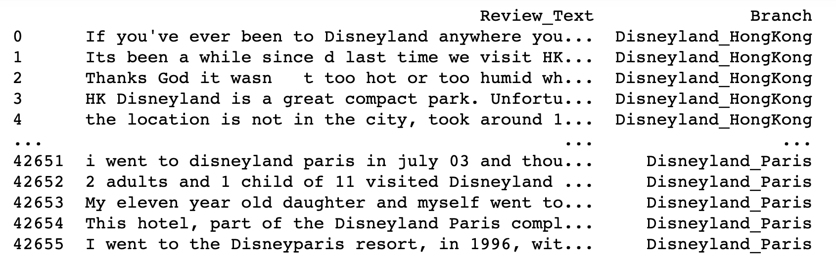
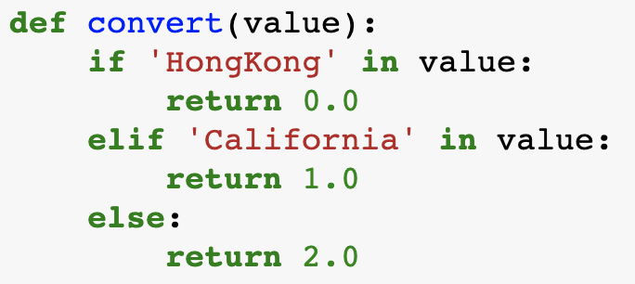
Data Preprocessing
STEP 1:
Remove the keywords ‘Paris’, ‘California’, and ‘Hong Kong’ to avoid any obvious text that may classify a specific park.
Convert each branch to a unique ID (1,2,3)

Slide 5



Data Preprocessing
STEP 2:
Get the top words and create a matrix with the words and the positions based on the dictionary
10K matrix
STEP 3:
Tfidf is created: Term Frequency Inverse Document Frequency.
This is an array for each review, with x[0] representing the branch ID, and x[1] being an array of the frequency of each word

Slide 6
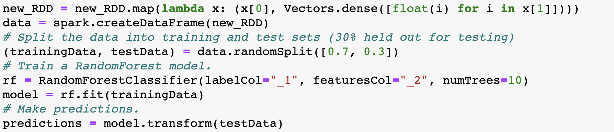
Model Implementation
New_RDD is the TF-IDF
convert RDD to a dataframe
Split data into training and testing (70% training, 30% testing)
Fit the model on the training data
Get predictions on the test data

Slide 7
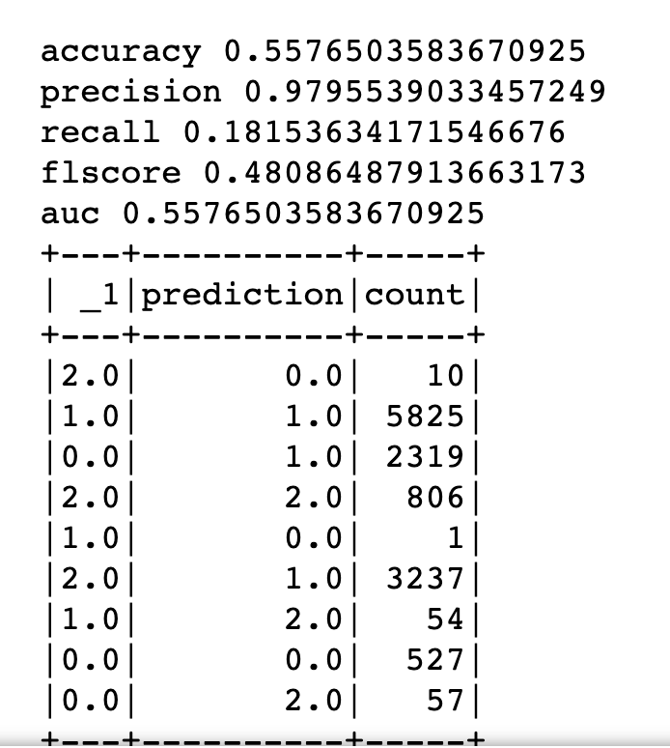
Model Results and Performance
Overall Performance was 56%
The model was best at classifying reviews from Disneyland located in California
Metric | value
Accuracy | 55.76%
Precision | 97.95%
Recall | 18.15%
F1score | 48.09%
AUC | 55.77%
class | correct | incorrect | Accuracy
0: Hong Kong | 527 | 2376 | 18.15%
1: California | 5825 | 55 | 99.06%
2: Paris | 806 | 3237 | 19.94%

Slide 8
Interpreting Model Results
Top words based on feature importance
Many of the differentiating words revolved around ethnicity, weather, or key aspects of the theme parks. For example, the gulch is a specific themed land located in Hong Kong.
hk, queues, mtr, show, lion, hopper, king, chinese, good, toilets, queue, passes, france, disneyland, princess, parks, small, half, asian, disney, downtown, queued, tokyo, crowds, pm, lack, world, cold, holiday, line, kids, loads, coaster, term, lovely, mainland, euros, jones, nights, french, size, cover, stayed, big, staff, fault, prepared, grotto, fantasmic, studios, dont, party, fact, euro, splash, pan, illuminations, golden, grizzly, indian, thought, fun, system, mansion, occasional, come, tour, conditioned, rained, day, otherwise, backpack, orleans, water, cantonese, arena, sleeping, clearly, following, charm, du, week, shanghai, broken, morning, run, get, hkd, instructions, stalls, rer, train, rather, running, amusement, make, gulch, americans, caught, worry

Slide 9
Conclusion
Although the overall performance of the model was below what was expected, the model performed well in classifying reviews from Disneyland in California.
The top 25 words that differentiated between park type were: hk, queues, mtr, show, lion, hopper, king, chinese, good, toilets, queue, passes, france, disneyland, princess, parks, small, half, asian, disney, downtown, queued, tokyo, crowds, pm
Next Steps: As a next step, it would be interesting to expand this project to also look at ratings (1-5), as well as dive in deeper to look at the top words associated with each park.

